Slide 1
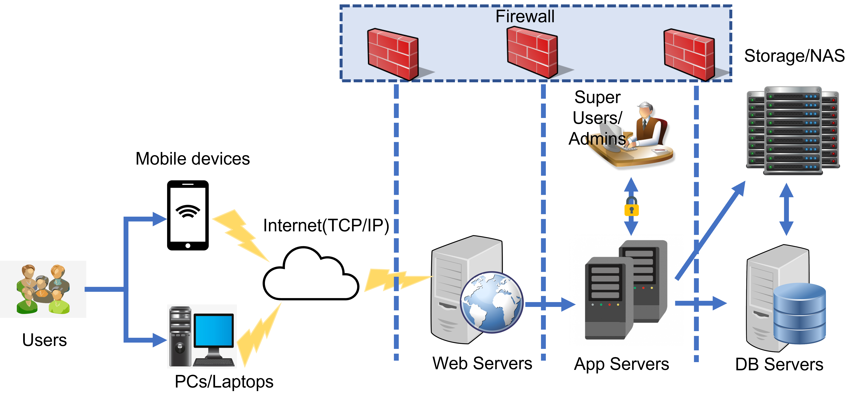
Application: FoodPantry Type: Application Architecture View: Process View Style: Client-Server Pattern

